Slide 1
Making
Observations
How We Look at Things in Science

Slide 2
Observation Outcomes
Make observations and collect information relevant to a given question or problem (205-5).
Record observations using a single word, notes in point form, sentences, simple diagrams and charts (205-7).

Slide 3
What is an observation?
An observation:
describes the characteristics, properties, differences, similarities and changes of an object or event.
can be made directly using the 5 senses or indirectly through the use of simple or complex instruments.
is a fact not personal opinion.

Slide 4
Types of Observations
There are two types of observations:
    Quantitative (numeric)
    Qualitative (non-numeric)

Slide 5
Qualitative Observations:
describe the qualities of an object or event. Examples include colour, taste, sound, texture appearance, behavior.
are not numeric.
difficult to measure.

Slide 6
Qualitative Observation
Examples:
It is warm outside.
The ant’s antennae twitch.
The car is dark blue.
The concert is very loud.

Slide 7
Quantitative Observations:
are measurable.
are numeric (can be counted or measured).
allow us to be more accurate in our description of the object or event.
typically involve the use of an instrument.

Slide 8
Quantitative Observation
Examples:
It is 20ºC outside.
The ant has 2 antennae
The car is travelling at 75 Km/h.
The concert is registering at 145 decibels.
The dog weighs 22.6 kg

Slide 9
Comparing
Qualitative Quantitative
It is cold.
The dog is big.
The car is moving fast.
The music is loud.
It is -20ºC.
The dog weighs 22.6 kg.
The dog is 120 cm long.
The dog’s volume is 2.95m³.
The car is travelling at a speed of 75 km/h.
The music is registering at 145 decibels.

Slide 10
Recording observations
Observations can be recorded using various methods such as:
- a single word
notes in point form
sentences
simple diagrams
charts

Slide 11
Inference
Inferring is….
using logic and reason to develop explanations from observations.
Sometimes we have to “read between the lines”.
We use prior knowledge to infer: purpose, intent, or cause and effect.

Slide 12
Here are some examples
Observation Inference
That plant is extremely wilted.
The car stopped running
The Wildcats are leading their division
That plant is extremely wilted due to a lack of water.
The car stooped running because it was out of gas.
The Wildcats are leading their division because they are playing well right now.

Slide 13
State an Inference
Observations | Inference
I hear people screaming. I smell cotton candy, popcorn, and hamburgers I see a lot of people

Slide 14
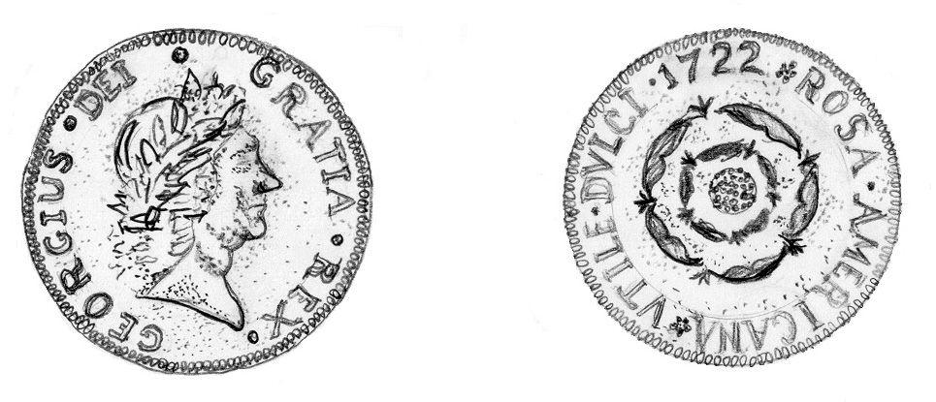
Observation or
Inference
A face is present on one side of the coin.
The Latin word "Dei" means "God.“
The coin was made by deeply religious people.
The date 1722 is printed on one side of the coin.
The coin was made in 1722.
The face on the coin is a representation of the nation's president.

Slide 15
Look at the picture & decide if the statement is an
Observation or
Inference
Let’s Practice….

Slide 16
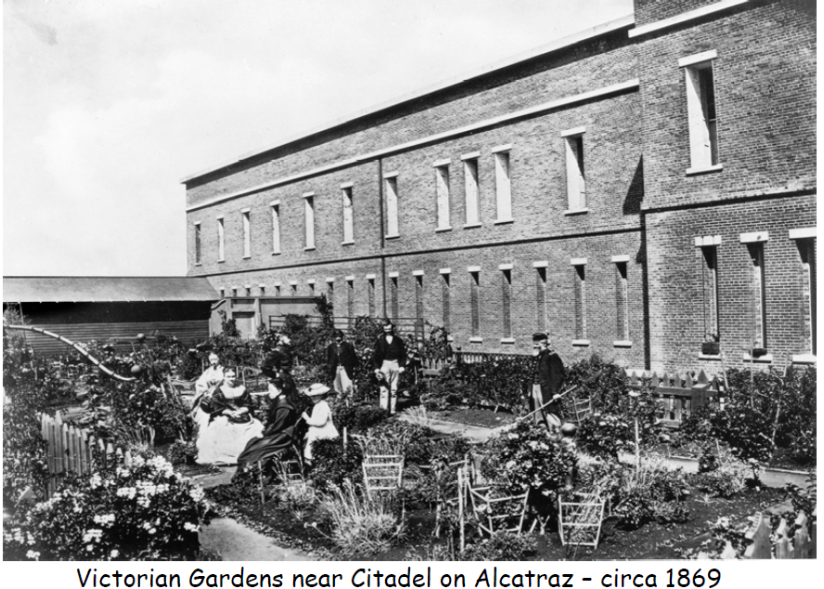
The narrow windows were used as rifle slits.
Inference
Notes:
Click on the title and slide it down to reveal the answer.

Slide 17
Observation
There was a garden located outside the Citadel.
Notes:
Click on the title and slide it down to reveal the answer.

Slide 18
Inference
Gardens were an important part of everyday life during the military years on Alcatraz Island.
Notes:
Click on title and slide it down to reveal the answer.

Slide 19
Inference
People in the garden are in mourning
Notes:
Click on title and slide it down to reveal the answer

Slide 20
Observation
The citadel was made of brick.
Notes:
Slide down the title to reveal the answer

Slide 21
There is a picket fence.
Observation.
Notes:
Slide down the title to reveal the answer

Slide 22
People used to spend more time outside.
Inference

Slide 23
The garden provided food for the families living on Alcatraz.
Inference

Slide 24
Observation
There were no cannons on Alcatraz.

Slide 25
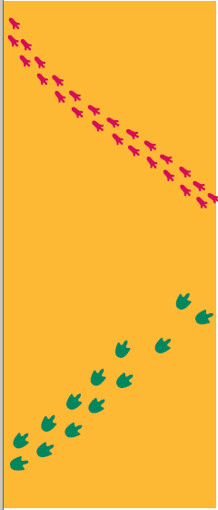
Look at these two sets of animal tracks.
Make 3 OBSERVATIONS and one INFERENCE

Slide 26
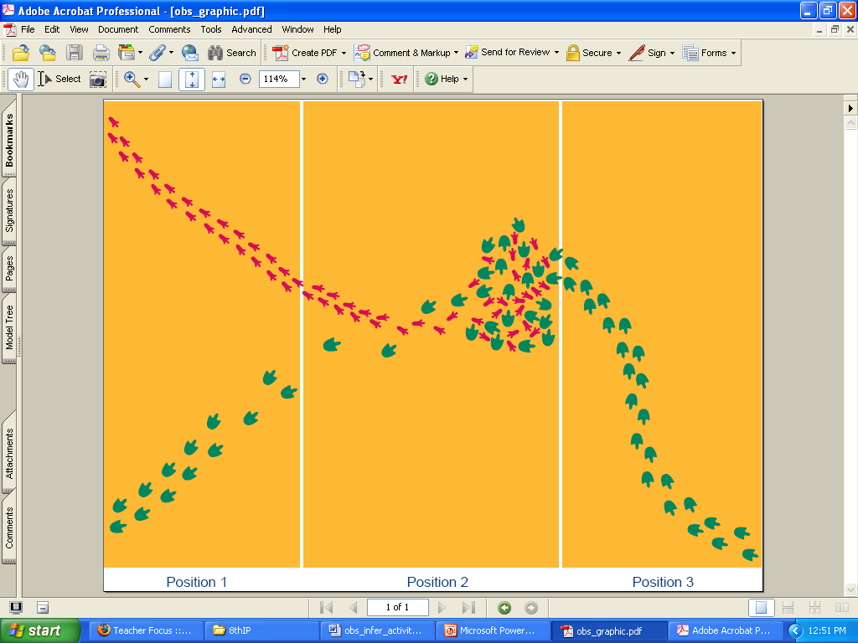
Now what do you think?
Make 3 OBSERVATIONS
Make an INFERENCE

Slide 27
Now what do you think?
Make 3 OBSERVATIONS
Make an INFERENCE

Slide 28
When to Use
During experiments, record observations NOT inferences
Inferences may be used when writing the conclusion in your lab report.

Slide 29
References
www.middleschoolscience.com/...Observation_Inference-isn.ppt
www.learnnc.org/lp/pages/998
www.nps.gov/.../upload/Questioning_Artifacts-Observation_worksheet.pdf

